Slide 1
FirstLove Missions
Proclaiming the Gospel, Equipping the Church

Slide 2
Discussion Points
Beliefs & Practice
Foundational Principles
Mission Statement
Personnel & Ministry
Structure
How FLM Operates
Future of FLM

Slide 3
1 Beliefs & Practice

Slide 4
Tell me about FLM.
Is it just another
traditional missions
organization?

Slide 5
Short answer . . . No.
And here’s why . . .

Slide 6
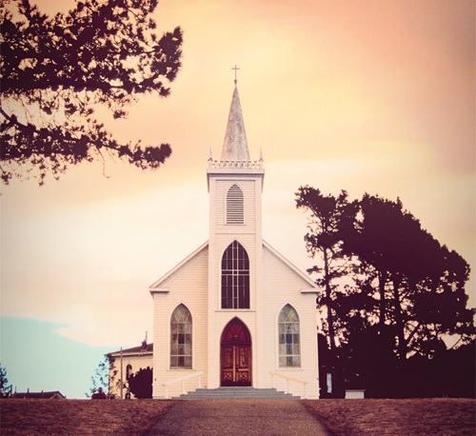
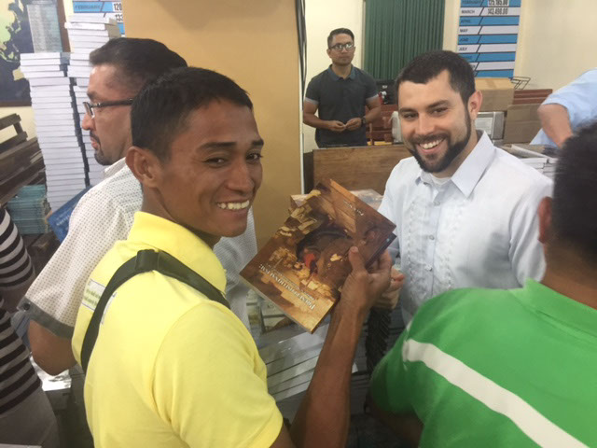
FirstLove Missions . . .
Is subject to a local church
Operates under biblical authority
Is a free grace ministry

Slide 7
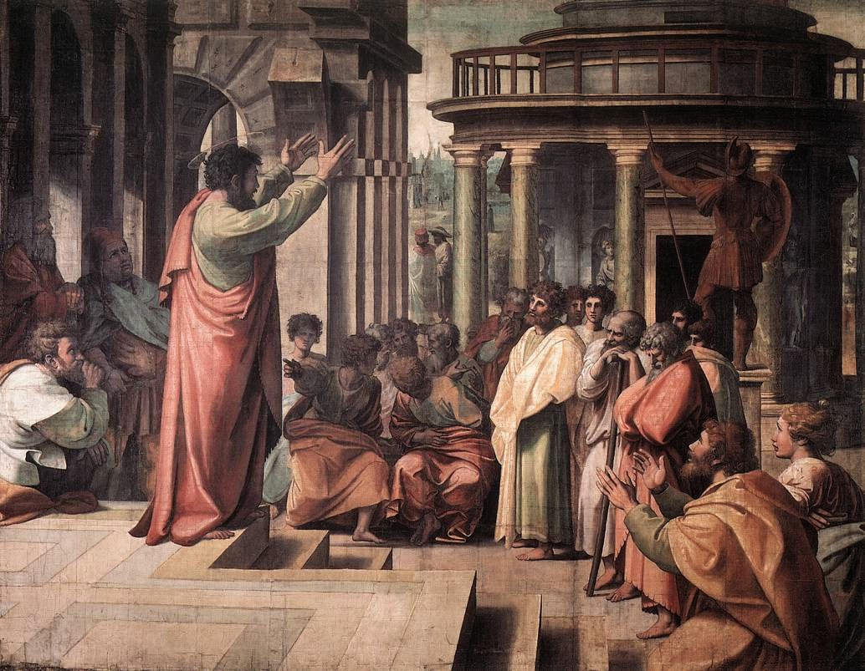
FirstLove Missions . . .
Follows a biblical, not business, construct
Does not solicit funds or donations
Implements checks and balances

Slide 8
FLM seeks to reclaim
the biblical foundations
of the past.

Slide 9
A Tale of Two Methods
The past . . .
The present . . .
Local churches sent out missionaries (e.g., Acts 13)
Guided by Scripture
Authority of the Lord Jesus Christ (Matt. 16)
Emphasized the “euangelion”
Parachurch organization
Not necessarily under biblical authority
Few, if any, checks and balances
Business construct
De-emphasis on preaching; increase in humanitarian efforts
Mandatory financial solicitation before departing

Slide 10
Okay, so you want to
return to the basics. What does that mean for your
priority in missions?

Slide 11
Our Priority
Exclusivity of the Word of God.
Gospel proclamation precedes humanitarian efforts.
Instead of soliciting finances, our missionaries are freed to engage in the work of evangelism.

Slide 12
What is your reason for approaching missions this way?

Slide 13
Three Reasons (from Scripture)
1
The Divine Reality
2
The Divine Promise
3
The Divine Imperative

Slide 14
The Divine Reality
The Lord has His chosen people from every nation, tribe, people, and tongue (Rev. 7:9).
Sensational, hyped claims of WOF preachers.
God’s elect are waiting to hear the gospel.
The promises guarantee fruit and provide comfort.
“Now the Lord spoke to Paul . . . ‘do not be afraid, but speak, and do not keep silent . . . for I have many people in this city’ ” (Acts 18:9–10).
“Who then is Paul, and who is Apollos, but ministers through whom you believed, as the Lord gave to each one? I planted, Apollos watered, but God gave the increase” (1 Cor. 3:5–6).

Slide 15
The Divine Promise
Prophetic dilemma? The bad news:
“And there will be signs in the sun, in the moon, and in the stars; and on the earth distress of nations, with perplexity, the sea and the waves roaring; men’s hearts failing them from fear and the expectation of those things which are coming on the earth, for the powers of the heavens will be shaken. Then they will see the Son of Man coming in a cloud with power and great glory” (Luke 21:25–27).
“For many will come in My name, saying, ‘I am the Christ,’ and will deceive many” (Matt. 24:5).

Slide 16
The Divine Promise (Cont.)
Prophetic dilemma? The bad news:
“Then many false prophets will rise up and deceive many. And because lawlessness will abound, the love of many will grow cold” (Matt. 24:11–12).
“For false Christs and false prophets will rise and show great signs and wonders to deceive, if possible, even the elect” (Matt. 24:24).

Slide 17
The Divine Promise (Cont.)
Prophetic dilemma? The good news:
“For the earth shall be full of the knowledge of the Lord as the waters cover the sea” (Isa. 11:9).
“And this gospel of the kingdom will be preached in all the world as a witness to all the nations, and then the end will come” (Matt. 24:14).

Slide 18
Bad news. Good news. Which one?
Is there a solution?

Slide 19
Yes.
Antinomy.

Slide 20
Defining Our Terms
Antinomy. an· tin· o· my. noun. A contradiction between two statements, both apparently obtained by correct reasoning.
Both are T-R-U-E.
The divine promise remains true: the gospel of Christ and the knowledge of God will cover the earth as a witness to the nations.

Slide 21
The Divine Imperative
Our job is to bring the word of God to the world:
“Thus it is written, and thus it was necessary for the Christ to suffer and to rise from the dead the third day, and that repentance and remission of sins should be preached in His name to all nations, beginning at Jerusalem” (Luke 24:46–47).
“And He said to them, ‘Go into all the world and preach the gospel to every creature’ ” (Mark 16:15).
“The fruit of the righteous is a tree of life, and he who wins souls is wise” (Prov. 11:30).

Slide 22
Divine Imperative (Cont.)
“All authority has been given to Me in heaven and on earth. Go therefore and make disciples of all the nations, baptizing them in the name of the Father and of the Son and of the Holy Spirit, teaching them to observe all things that I have commanded you; and lo, I am with you always, even to the end of the age” (Matt. 28:18–20).
“Those who are wise shall shine like the brightness of the firmament, and those who turn many to righteousness like the stars forever and ever” (Daniel 12:3).

Slide 23
Divine Imperative (Cont.)
“How then shall they call on Him in whom they have not believed? And how shall they believe in Him of whom they have not heard? And how shall they hear without a preacher? And how shall they preach unless they are sent? As it is written: ‘How beautiful are the feet of those who preach the gospel of peace, Who bring glad tidings of good things!’” (Rom. 10:14–15).

Slide 24
2 Foundational Principles
1 Beliefs & Practice

Slide 25
Principle #1: Proclaim
Proclaim the gospel . . . and the whole counsel of God.
Pursued in three ways:
Spoken Word
Written Word
Technology

Slide 26
Proclaim the Gospel
Spoken Word
Preaching
Teaching
Street evangelism
Personal testimony
College/University outreach
Special events
Written Word
Free literature distribution
Prison ministry
Military evangelism
Technology
Internet
Social media
CDs
Podcasts

Slide 27
Principle #2: Equip
Equip the saints for the work of the ministry.
Adapt to local culture and indigenous situations to address each unique ministry concern.
A two-fold approach to “equip.”

Slide 28
Two Groups, Two Ways
Equip missionaries
Certificate of Ministry
FLM Handbook (forthcoming)
Equip the church
FLP literature
Seminary/Bible Institute/Bible School
Personal apologetics & discipleship
Conferences
Mentoring

Slide 29
Principle #3: Develop
Fostering a biblically sound worldview.
Helping the saints mature in the faith (from milk to meat, Heb. 5:12).
Doing God’s work, God’s way.
Getting from this . . . to this . . .

Slide 30
What does
development
look like?

Slide 31
Mature Believers
Looks like . . . ?
Souls saved
Sanctified saints
Serving others by using spiritual gifts in a local church
How?
Follow-up and accountability
Mentoring (believers and leaders)
Discipleship (teaching/catechizing)
Staying in touch/communicating

Slide 32
These three foundational principles lead to our
primary purpose . . .

Slide 33
3 Mission Statement
1 Beliefs & Practice
2 Foundational Principles

Slide 34
Mission Statement
Proclaiming the gospel at home and abroad, equipping the saints worldwide for the work of the ministry, and developing a biblically sound worldview for the deepening of the knowledge of Christ, for the preservation of the Church’s first love, for the salvation of souls, for the glory of God.
Proclaim
the glorious gospel
Equip
pastors and churches
Develop
the next generation of disciples

Slide 35
4 Personnel & Ministry Structure
1 Beliefs & Practice
2 Foundational Principles
3 Mission Statement

Slide 36
A new paradigm in
organizational structure.
(needed)

Slide 37
Corporate Structure
CEO
Managers / Supervisors
Workers
Vice
President
Sr.
Pastor
Deacons / Staff
Church Members
Associate Pastor(s)
Corporate Mentality
Corporate-Church Mentality

Slide 38
A Radical Structure
Working together to serve Christ
CEO
Managers / Supervisors
Workers
Vice
President
Church Members
Deacons & Staff
Elders/
Pastors
Corporate Mentality
Biblical Mentality

Slide 39
So what does FLM’s organizational structure look like?

Slide 40
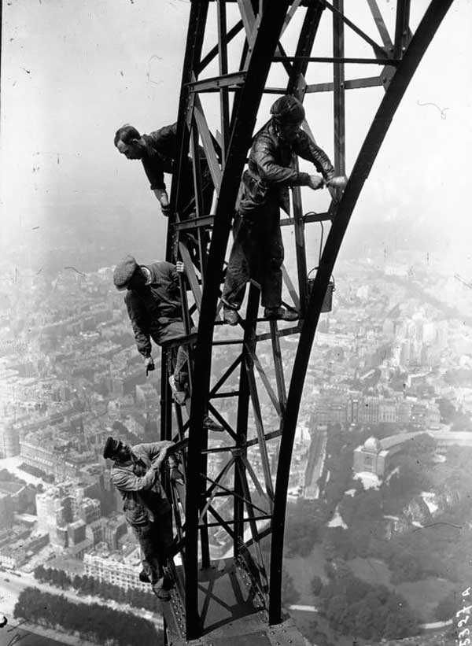
Working Together
Director
Advisors
Missionaries & Missionary Workers
Financial Officer
FLP Managing Editor
FLM Administrator
Warehouse / Order Processing Manager
For the glory of God,
for the edification
of the sheep.

Slide 41
Tell me a little more about
key stakeholders working together at FLM.

Slide 42
So who does what?

Slide 43
Board of Advisors
Accountability for the resources that God has entrusted to FirstLove Missions begins with the recognition that God requires us to be good stewards of His money. The parable of the master and the wise steward is just as applicable today as it was during the life and ministry of our Lord. We are also keenly aware that individuals who give of their prayers, time, and money to FirstLove Missions likewise view us as stewards. For these reasons, it is our objective to listen to individuals whom the Lord uses to help shape us into a better ministry each and every day for His glory. We see value and wisdom in taking advice from godly men as they advise us in the work of the ministry and the best use of God's gracious gifts. Given our understanding of humanity's frailty and inherent corruptibility, checks and balances are essential. We have put such mechanisms in place to make a statement that everyone associated with FirstLove Missions wants to be above reproach in all that we do. For this reason, our own board of advisors meets regularly to discuss how we have used the resources given to us and the direction and performance of the ministry going forward.

Slide 44
Board of Advisors (Cont.)
Advise the Director.
Accountable for resources God has entrusted to FLM.
Make recommendations on missions and publications matters.
Currently (but not exclusively) comprised of:
6-member panel
All ordained pastors
All have teaching experience
All have short-term missions experience and/or knowledge and familiarity

Slide 45
FLM Administrator
Coordinates logistics for all FLM-sponsored conferences in the U.S.
Assists local POC for all FLM-sponsored conferences overseas (as required).
Responsible for maintenance, upkeep, and development of FLM website.
Responsible for obtaining mission updates from FLM missionaries.
Responsible for mission reports.
Responsible for the training and development of FLM missionaries.

Slide 46
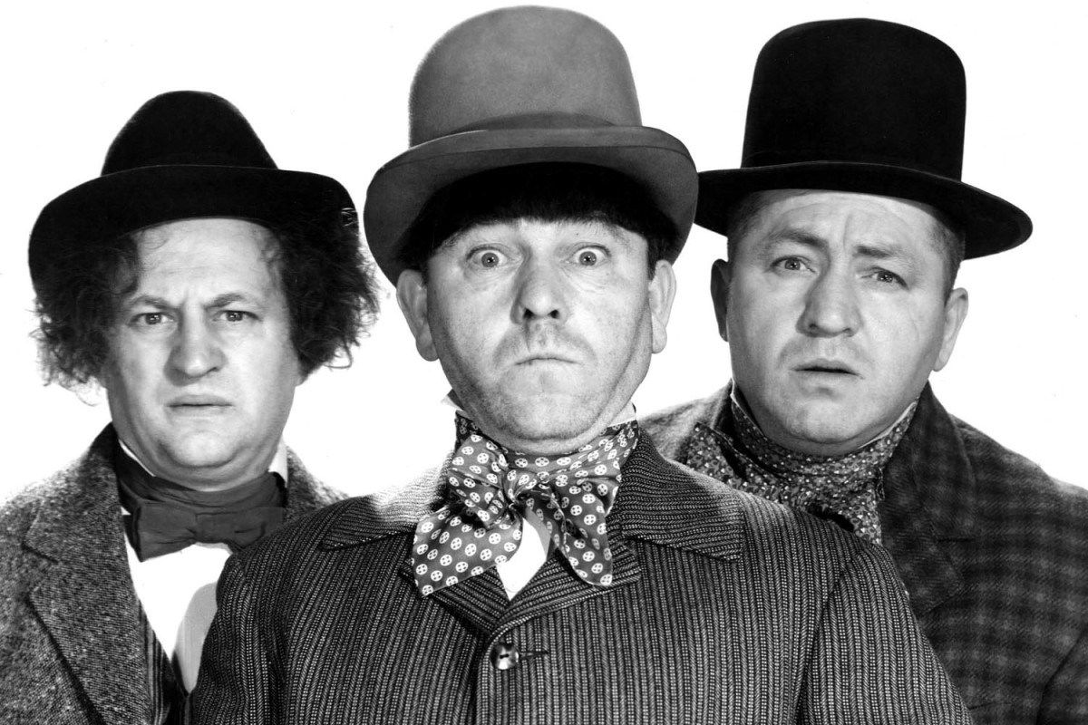
FLM Administrator (Cont.)
Travels to the mission field for encouragement, teaching, preaching, and personal discipleship.
Responsible for helping maintain the quarterly FLM/FLP magazine with the Financial Officer and FLP Managing Editor.
Assists the Director as required.
Anything else?!

Slide 47
FLM Missionary
An individual who has experienced the Holy Spirit’s leading to proclaim the gospel to the unchurched and who has previously demonstrated a willingness to labor together with us by:
Participating in short-term missions
Engaging in evangelism efforts (street preaching, personal witnessing, discipleship, etc.)
Distributing FLP literature
Presenting the FLP/FLM ministry overview seminar

Slide 48
So how can I become
an FLM missionary?

Slide 49
Essential Requirements
Be a born-again Christian.
Member in good standing of a Bible-believing local church.
Recommended from a local pastor.
Complete the 3-step certification process.
Jesus answered . . . “I say to you, unless one is born again, he cannot see the kingdom of God . . . You must be born again” (John 3:3–7).
“Not forsaking the assembly of ourselves together” (Heb. 10:25; see also Col. 3:16; Acts 2:42; Eph. 4:12)

Slide 50
Missionary Certification
Complete the missionary application.
Complete the “Certificate of Ministry” within six months of commencement.
Confirmed as an FLM Missionary under the auspices of FirstLove Missions.
Book 1: The New Testament Missionary (Cliff Hellar) and Study Guide
Book 2: The Minister as Shepherd: The Privileges and Responsibilities of Pastoral Leadership (Charles E. Jefferson) and Study Guide
Book 3: A Catechism on Biblical Doctrine: With Commentary (W. R. Downing) and Study Guide

Slide 51
Any other requirements
for FLM missionaries?

Slide 52
Continuing Training
All FLM missionaries will pursue and complete Level 2 training beyond the initial Level 1 “Certificate of Ministry.” This further study will concentrate on the lives of notable missionaries and evangelists from Christian history.
Book 1: Biography of George Muller and Study Guide.
Book 2: Biography of Hudson Taylor and Study Guide
Book 3: Biography of George Whitefield and Study Guide

Slide 53
Are there ministry opportunities with FLM, without being a dedicated FLM missionary?
(Short answer . . . Yes!)

Slide 54
FLM Missionary Worker*
For a “Titus 2” man or woman who feels the Holy Spirit’s leading to assist FLM missionaries to engage in gospel outreach and evangelism in a number of practical ways, to include:
Personal evangelism
Discipleship of believers
Literature set-up
Literature distribution
Photography
Videography
General set-up and clean-up
Logistical support
Bible studies
Testimonies
*Same “essential requirements” apply: born again, church member, recommended by a pastor.

Slide 55
Are FLM missionaries required to candidate and campaign for their ministry funding?

Slide 56
Financial Policy
We are a faith ministry and are convinced God will provide the funds necessary for us to support missionaries and workers who are led to proclaim the gospel.
None of our missionaries solicit funding.

Slide 57
Surely, FLM must have key donors who are underwriting the ministry, correct?

Slide 58
By Faith We Operate
We are not supported by government grants but purely by free-will gifts from local churches and individuals as led by the
Lord.
Churches partner with us in volunteer, advisory, spiritual, and financial support.

Slide 59
Cooperating Churches
Sovereign Grace Baptist Church, Versailles, Kentucky
Sovereign Grace Baptist Church, Dale City, Virginia
Christ Evangel Christian Fellowship, Milton, Florida
Sovereign Grace Baptist Church, Morgan Hill, California
Christ Bible Church, Dublin, California

Slide 60
So where have you been able to minister geographically?

Slide 61
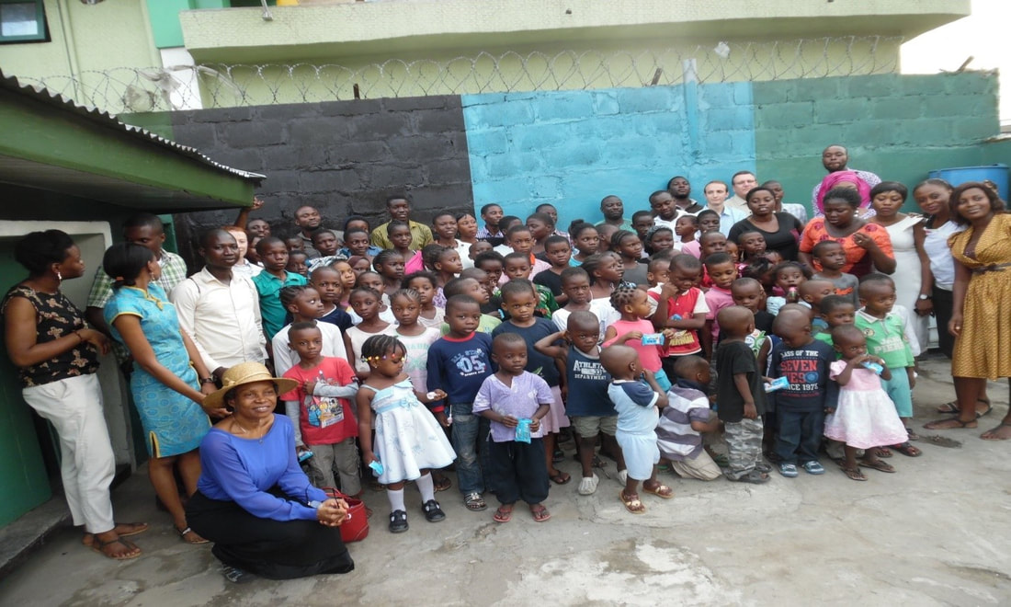
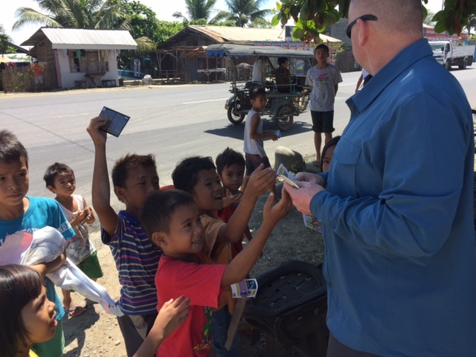
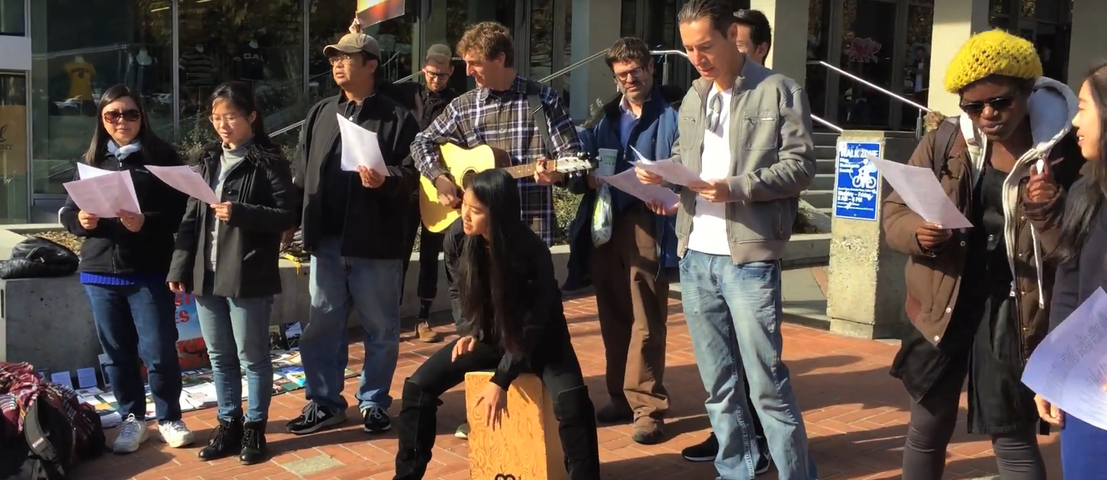
Ministry Structure Today
Currently operating in 3 regions:
Africa
Asia
N. America
Nigeria
India
Nepal
Philippines
United States

Slide 62
How do you share the ministry workload?

Slide 63
5 How FLM Operates
1 Beliefs & Practice
2 Foundational Principles
3 Mission Statement
4 Personnel & Ministry Structure

Slide 64
Regional Managers
Responsible for operations and logistics in a country and liaison directly with the FLM Administrator and Warehouse Manager.
India: Pastor David Gerald
Nepal: Pastor Samuel Rai
Nigeria: Pastor Tony Okoroh
Philippines: Pastor Leo / Hannah Galanza
United States (East): Tom Smith
United States (South/Central): Austin Huggins
United States (West): Brian Luzny

Slide 65
What evangelism efforts do you provide for each of these countries?

Slide 66
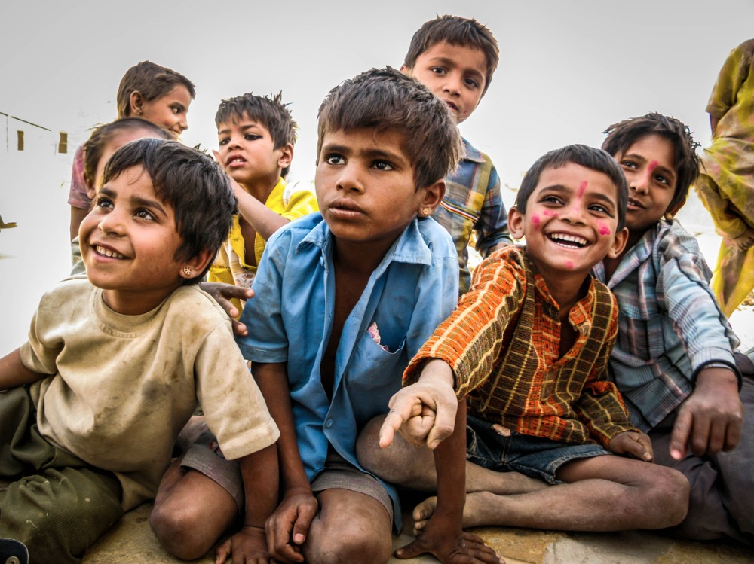
India
Pastors’ Conferences
Bible Colleges & seminaries
Literature Distribution
Book Translations
Ministry focus: Islam & Hinduism

Slide 67
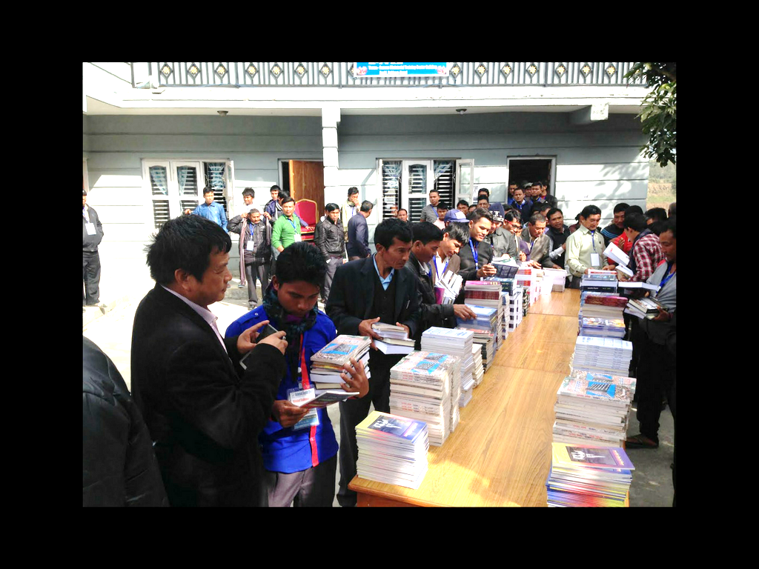
Nepal
Pastors’ conferences
Literature distribution
Book translations
Ministry focus: Hinduism & Buddhism

Slide 68
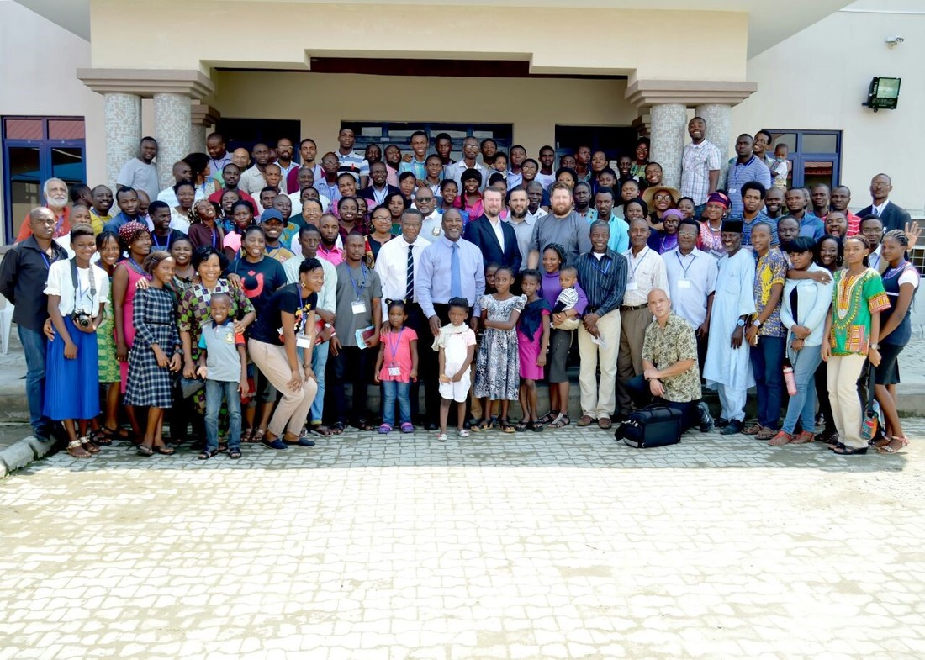
Nigeria
Sovereign Grace Bible Church
Christ Pastors’ Seminary
Free Grace Bible Institute
Radio Ministry
Annual conferences
Literature distribution
Children’s ministry
University & College outreach
Ministry focus: Islam & Word of Faith

Slide 69
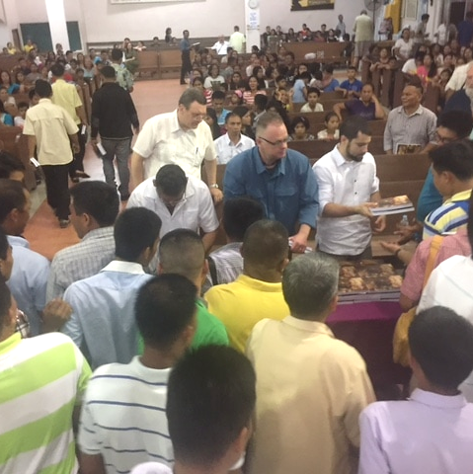
Philippines
Pastor’s Conferences
Seminary & Bible College lectures
Church conference, lectures, & seminars
Church evangelism
Literature distribution
Ministry focus: Catholicism & addictions

Slide 70
United States
Conferences
Ministry presentations
Preaching & teaching
Evangelism
Personal mentoring
Personal discipleship
University & College outreach
Literature distribution
Ministry focus: Multiculturalism & apathy

Slide 71
Looks good so far.
What does the future
of FLM look like?

Slide 72
6 Future of FLM
1 Beliefs & Practice
2 Foundational Principles
3 Mission Statement
4 Personnel & Ministry Structure
5 How FLM Operates

Slide 73
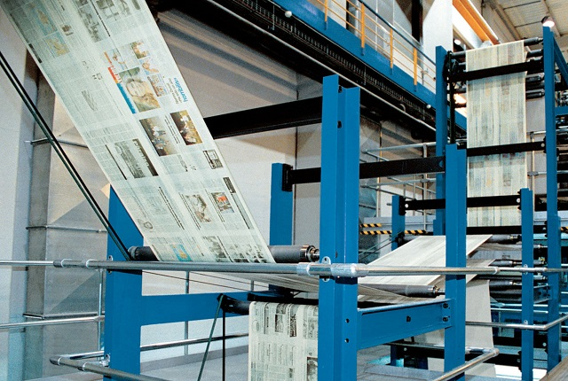
Today & On the Morrow
Today
Tomorrow
Print overseas
Annual conferences
Volunteer workers
Own print shop with full-time employees
Publishing staff
Free Grace Bible Institute
Expanded tract ministry
Provide libraries for pastors in developing countries
Establish pastors’ conferences overseas each month of the year
Create a Study Bible
Quarterly ministry magazine
Laminated doctrinal guides

Slide 74
To 2 0 2 0 & Beyond
Free literature distribution in all 50 states.
An outreach in every nation in the world.
Annual mission conferences on every habitable continent.
Freely distribute 1,000,000 books, booklets, & tracts worldwide.
Expanded outreach to minimum of 1 university / college campus in every state.
Translation of entire catalog into foreign languages.

Slide 75
To 2 0 2 0 & Beyond
Free literature distribution in all 50 states.
An outreach in every nation in the world.
Annual mission conferences on every habitable continent.
Freely distribute 1,000,000 books, booklets, & tracts worldwide.
Expanded outreach to minimum of 1 university / college campus in every state.
Translation of entire catalog into foreign languages.
Yes . . .every nation.

Slide 76
But how will you accomplish this? Is your goal of distributing literature and establishing missions work in every nation too big?

Slide 77
No, and here’s why

Slide 78
By Faith
Abraham believed the promise of God—though he waited many years for its fulfillment.
“By faith Abraham obeyed when he was called to go out to the place which he would receive as an inheritance. And he went out, not knowing where he was going. By faith he dwelt in the land of promise as in a foreign country, dwelling in tents with Isaac and Jacob, the heirs with him of the same promise; for he waited for the city which has foundations, whose builder and maker is God” (Heb. 11:8-10).

Slide 79
Faith
Will be tested in the fire, but God will keep His promises. He is faithful, and cannot lie.
“And what more shall I say? For the time would fail me to tell of Gideon and Barak and Samson and Jephthah, also of David and Samuel and the prophets: who through faith subdued kingdoms, worked righteousness, obtained promises . . .” (Heb. 11:32-33).

Slide 80
Promises to Embrace
God is pleased when we trust Him for great things. After all, HE gave us these promises:
“But Jesus looked at them and said to them, ‘With men this is impossible, but with God all things are possible’ ” (Matt. 19:26).
“So Jesus said to them, ‘Because of your unbelief; for assuredly, I say to you, if you have faith as a mustard seed, you will say to this mountain, “Move from here to there,” and it will move; and nothing will be impossible for you’ ” (Matt. 17:20).
“And have not shut me up into the hand of the enemy; You have set my feet in a wide place” (Psa. 31:8).

Slide 81
More Promises
HE also gave us these promises:
“So I say to you, ask, and it will be given to you; seek, and you will find; knock and it will be opened to you. For everyone who asks receives, and he who seeks finds, and to him who knocks it will be opened” (Luke 11:9–10).
“Another parable He put forth to them, saying, ‘The kingdom of heaven is like a mustard seed, which a man took and sowed in his field, which indeed is the least of all the seeds; but when it is grown it is greater than the herbs and becomes a tree, so that the birds of the air come and nest in its branches’” (Matt. 13:31–32).

Slide 82
More Promises (Cont.)
HE also gave us these promises:
So Jesus answered and said to them, ‘Assuredly, I say to you, if you have faith and do not doubt, you will not only do what was done to the fig tree, but also if you say to this mountain, “Be removed and be cast into the sea,” it will be done. And whatever things you ask in prayer, believing, you will receive’” (Matt. 21:21–22).
The effective, fervent prayer of a righteous man avails much. Elijah . . . prayed earnestly that it would not rain; and it did not rain on the land for three years and six months. And he prayed again, and the heaven gave rain, and the earth produced its fruit” (Jas. 5:16–18).

Slide 83
More Promises (Cont.)
HE also gave us these promises:
He who did not spare His own Son, but delivered Him up for us all, how shall He not with Him also freely give us all things?” (Rom. 8:32–33).
Now to Him who is able to do exceedingly abundantly above all that we ask or think, according to the power that works in us . . .” (Eph. 3:20).
“Who ever goes to war at his own expense? Who plants a vineyard and does not eat of its fruit? Or who tends a flock and does not drink of the milk of the flock?” (1 Cor. 9:7).

Slide 84
More Promises (Cont.)
HE also gave us these promises:
“For as the rain comes down, and the snow from heaven, and do not return there, but water the earth, and make it bring forth and bud, that it may give seed to the sower and bread to the eater, So shall My word be that goes forth from My mouth; It shall not return to Me void, but it shall accomplish what I please, and it shall prosper in the thing for which I sent it” (Isa. 55:10–11).

Slide 85
QUESTION.
If Abraham, an idol worshiper from Ur of the Chaldees, and George Muller and Hudson Taylor, can obtain the fulfillment of God’s promises—
WHY. CAN’T. WE?

Slide 86
I’m excited about FLM. Where can I find out more about FLM and ministry opportunities?

Slide 87
www.missionsfirstlove.org
Proclaiming The Gospel, Equipping The Church

