Slide 1
FirstLove Publications
For a biblically literate future

Slide 2
Discussion Points
Our Distinct Philosophy
History of FLP
Types of Literature
By the Numbers
FirstLove Missions

Slide 3
1 Our Distinct Philosophy

Slide 4
Mission Statement
To distribute free biblical literature, for the salvation of souls, to deepen the knowledge of Christ, to preserve the Church’s first love, for the glory of God.

Slide 5
The Printing Press
Mainz, Germany
The invention of the printing press by Johannes Gutenberg in 1440 was the catalyst that opened the possibility of the mass distribution of the word of God and the knowledge of God throughout the world via the printed page.

Slide 6
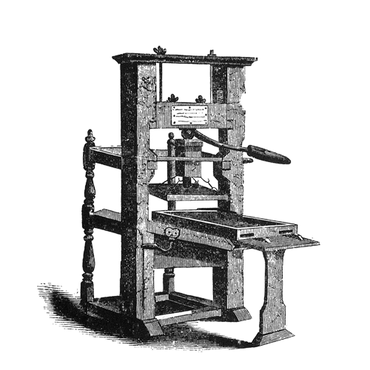
The Printing Press
In 1455, Gutenberg produced the first book ever printed and sold: a Latin language Bible printed in Mainz, Germany.
Gutenberg’s press created an immediate demand for printed books.

Slide 7
Christian Publishing Today
Generates billions of dollars for secular parent companies by selling Bibles and other Christian literature.
$8,630,000,000
fiscal year revenue for 2015

Slide 8
Biblical Principles (OT)
Temple service, sacrifices, and worship were both holy and sacred.
The mingling of money with the holy things of God brought God’s judgment upon the people.

Slide 9
Biblical Principles (NT)
Then Jesus went into the temple of God and drove out all those who bought and sold in the temple, and overturned the tables of the money changers and the seats of those who sold doves. And He said to them, “It is written, ‘My house shall be called a house of prayer,’ but you have made it a ‘den of thieves.’”
—Matthew 21:12–13

Slide 10
“
Today, Christian publishing has become an industry that is profit driven, when it should be ministry driven by love, regulated by biblical principles, and lead by Christians!
”

Slide 11
Biblical Principles
The buying and selling of Bibles and Christian literature has become so common few think to question the wisdom of it.
FirstLove Publications has the burden to freely distribute solid biblical literature as far and wide as possible—without charging a penny.

Slide 12
HOW?
We are a faith ministry.
We simply trust that God will continue to provide the funds necessary for His own people, as He has done so far.

Slide 13
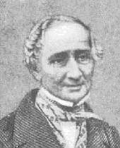
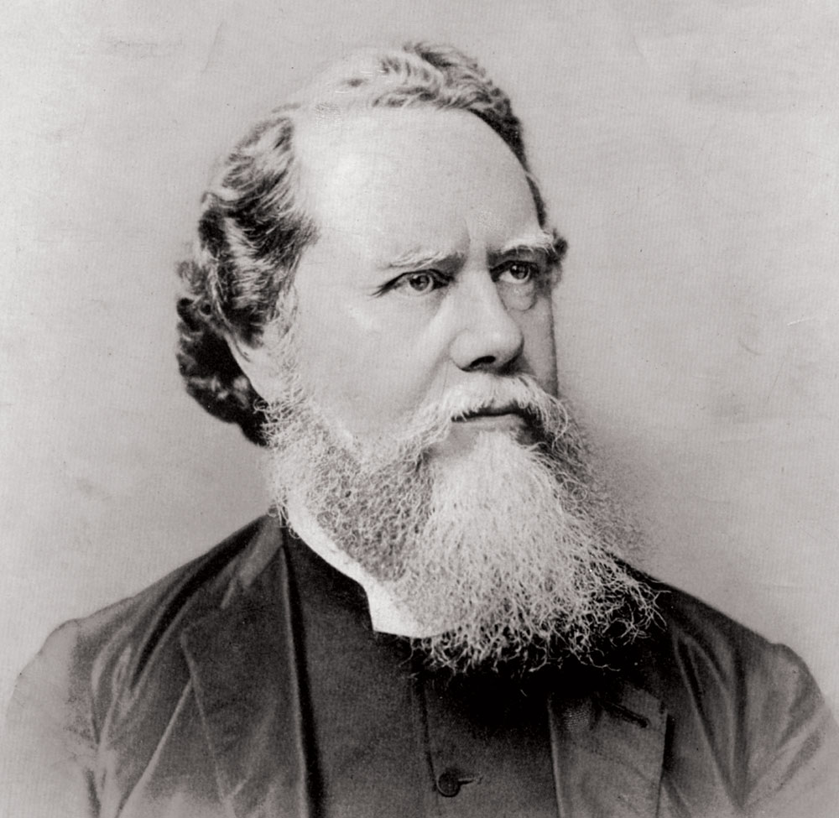
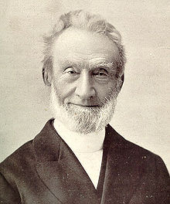
Faith Ministry
This is the way Anthony Groves did his missionary work, as well as Hudson Taylor, and also how George Müller built and ran his orphanages. They acquired God’s promises through prayer by faith—and God provided.
Anthony Groves
Hudson Taylor
George Müller

Slide 14
“
Depend on it. God’s work done in God’s way will never lack God’s supply. He is too wise a God to frustrate His purposes for lack of funds, and He can just as easily supply them ahead of time as afterwards, and He much prefers doing so.
”
—Hudson Taylor
Founder, China Inland Missions

Slide 15
“
My Lord is not limited;
”
He shall again supply.
—George Müller
Director, Ashley Down orphanage

Slide 16
WHY?
For global biblical literacy.
Our aim is to put God’s Truth into as many hands as we possibly can. Circulation is suppressed, however, when distribution depends on a financial transaction between a buyer and seller.
Our Lord Jesus said,
“Freely
you have received, freely give.”
For every book sold, we can distribute hundreds!

Slide 17
2 History of FLP

Slide 18
Beginnings
FirstLove Publications officially began in 2006 when Pastor Joe Jacowitz published “The New Testament Missionary” by missionary Cliff Hellar.

Slide 19
A Biblical Name
“Nevertheless, I have this against you, that you have left your first love.”
The name is taken from Revelation 2:4 where the Lord Jesus Christ exhorts the Ephesian church to hold on to its first love.
Maintaining love for Christ is vital for holiness, worship, and serving the Lord effectively.

Slide 20
Our Locations
Pokhara,
Nepal
Lexington,
KY
Pleasanton,
CA
All orders are filled and
shipped from Lexington, KY and shipped to FirstLove branches.
Kochin,
India
Manila,
Philippines
Lagos,
Nigeria

Slide 21
3 Types of Literature

Slide 22
5 Categories
Apologetics
Devotional
Doctrinal
Evangelistic
Pastoral
12+ Titles
15+ Titles
9+ Titles
7+ Titles
1+ Titles

Slide 23
4 By The Numbers

Slide 24
Books Available
Since the publication of our first book in 2006, our catalogue has grown to nearly 50 available titles, with another 40 titles in the publishing process.

Slide 25
Books Given Away
We have given away nearly 200,000 books to seminaries, churches, organizations, and individuals.
Our goal: to give away
1,000,000
b o o k s b y 2 0 2 0.

Slide 26
5 FirstLove Missions
Preaching the gospel,
equipping the church

Slide 27
2 Ministries In 1
FLP
FirstLove
Publications
FirstLove
Missions

Slide 28
Mission Statement
Proclaiming the gospel at home and abroad, equipping the saints worldwide for the work of the ministry, and developing a biblically sound worldview for the deepening of the knowledge of Christ, for the preservation of the Church’s first love, for the salvation of souls, for the glory of God.
Proclaim
the glorious gospel
Equip
pastors and churches
Develop
the next generation of disciples

Slide 29
FirstLove Missions
Provides:
Biblically sound books, booklets, and tracts.
Bible Study Courses to equip and train church members.
Pastors’ conferences, seminars, study tools, reference books, and Bible study courses for pastors and church leaders.

Slide 30
FirstLove Missions
Provides:
Seminars on gospel basics, personal and street evangelism, and discipleship for local churches.
Free food and transportation to seminars and conferences.
Free books and literature to Bible colleges and seminaries in developing countries.

Slide 31
Translated Works
Russian
Spanish

Slide 32
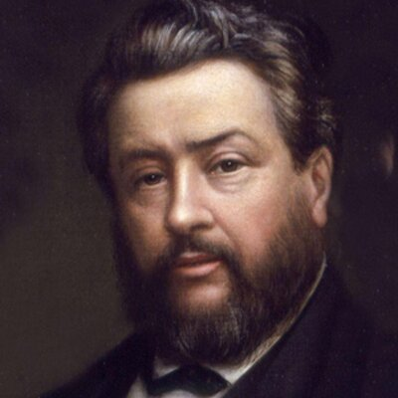
“
If one should spend one’s whole life for God, and win only one soul by the most earnest and devoted efforts, it would be a rich reward to see that one star shining forever in the firmament of heaven, to see that one gem glistening forever in the diadem of Christ, to see that one sheep feeding forever in the pastures of eternal life.
”
—C. H. Spurgeon
Nineteenth-century preacher

Slide 33
5 Places of Operations
Pokhara,
Nepal
Pleasanton,
California
Kochin,
India
Manila,
Philippines
Lagos,
Nigeria

Slide 34
Local Missions
Pleasanton, California

Slide 35
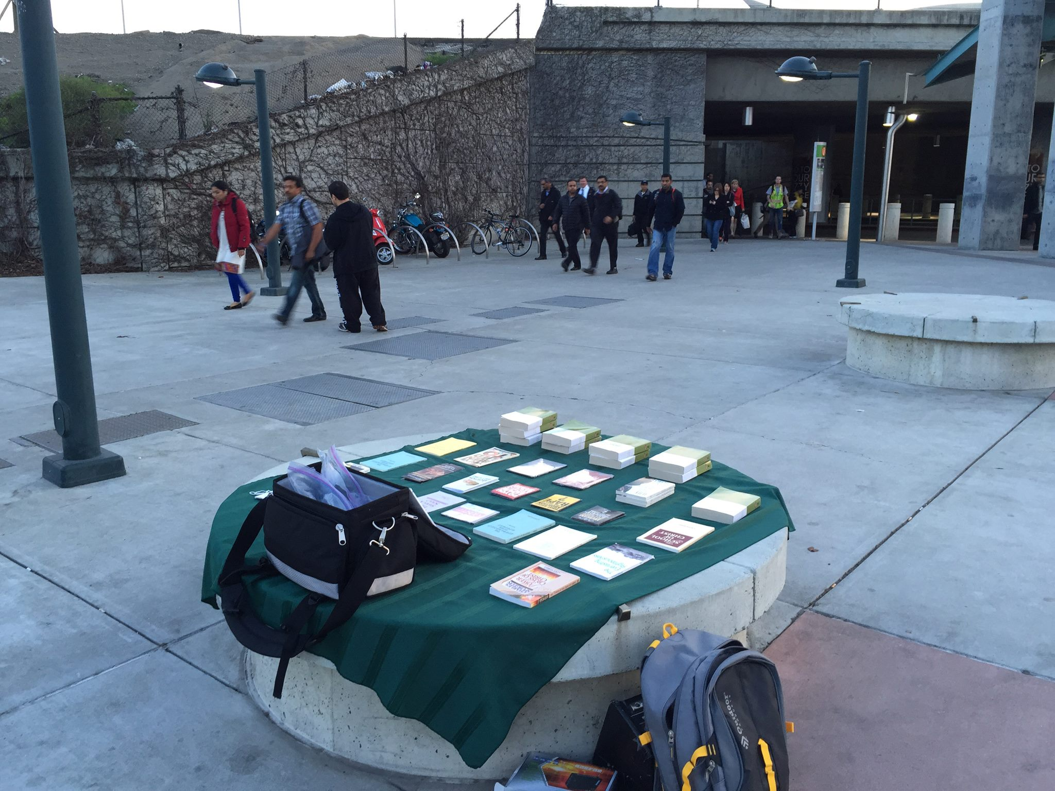
Literature & Street Evangelism

Slide 36
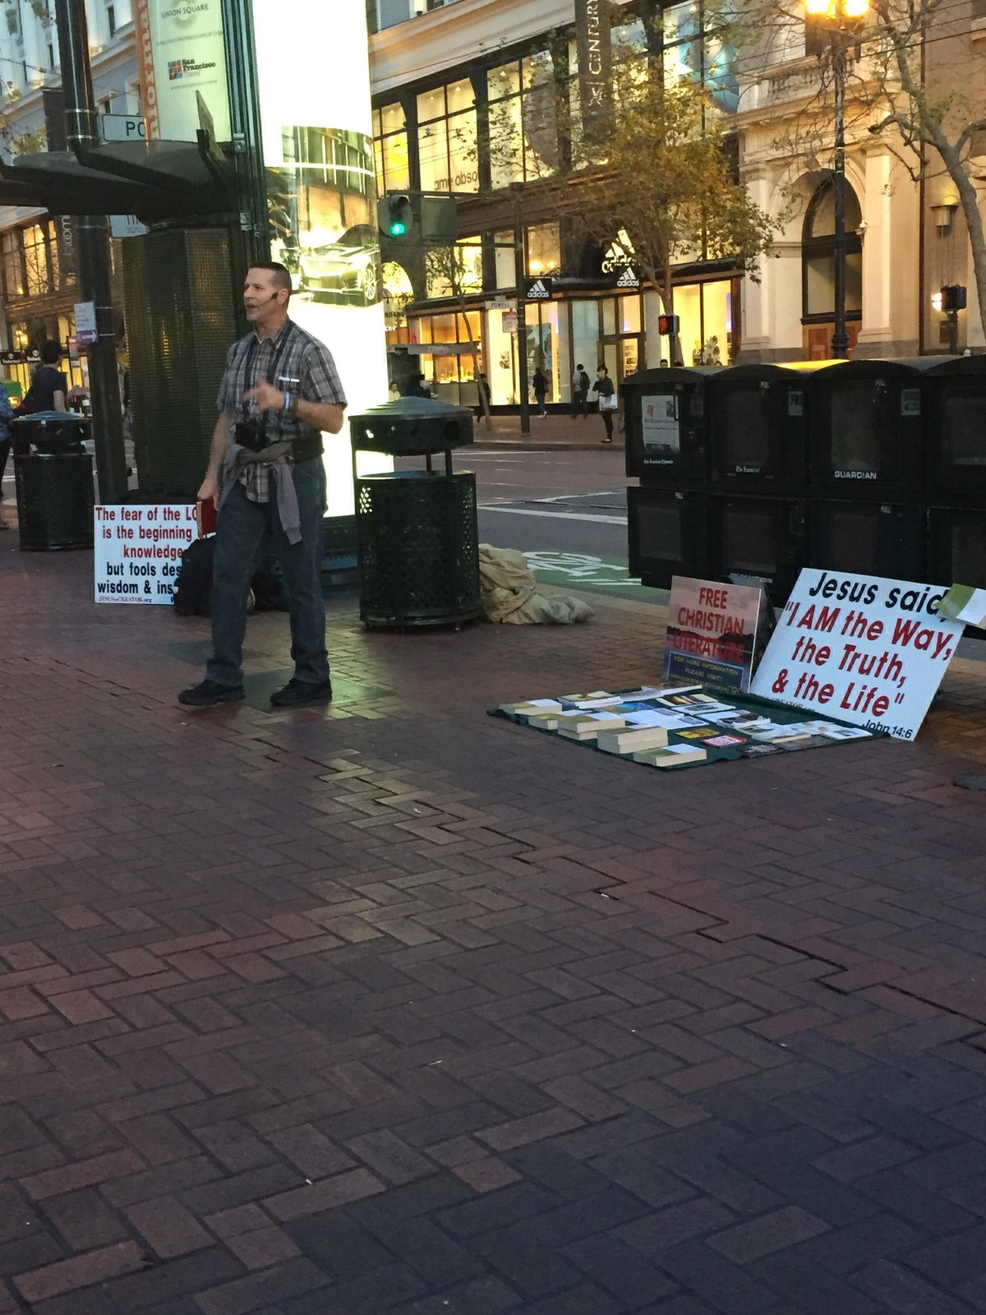
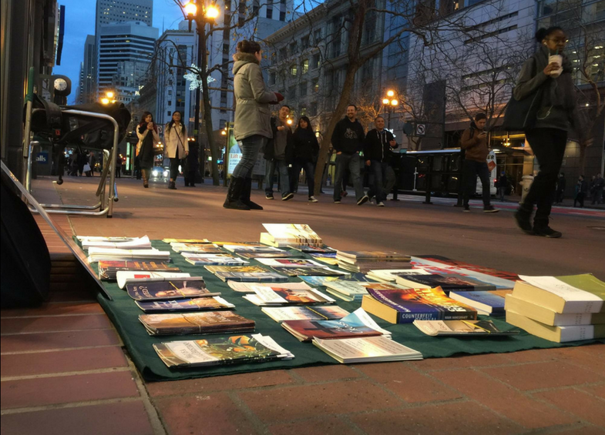
Literature & Street Evangelism

Slide 37
India Missions
Kochin, India

Slide 38
India Missions
Providing books to pastors, Bible colleges, conferences, and churches.

Slide 39
Philippines Missions
Manila, Philippines

Slide 40
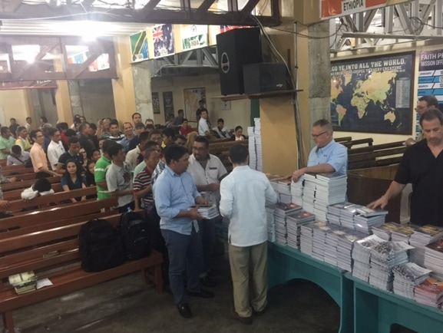
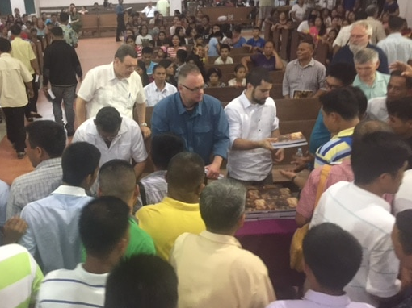
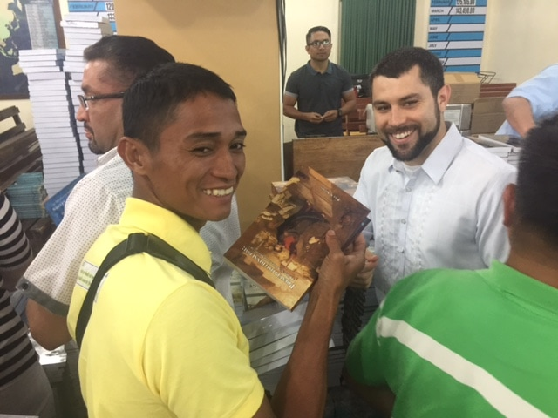
Philippines Missions
Providing biblical literature, pastors’ conferences, radio teaching, and training for children.

Slide 41
Nigeria Missions
Lagos, Nigeria

Slide 42
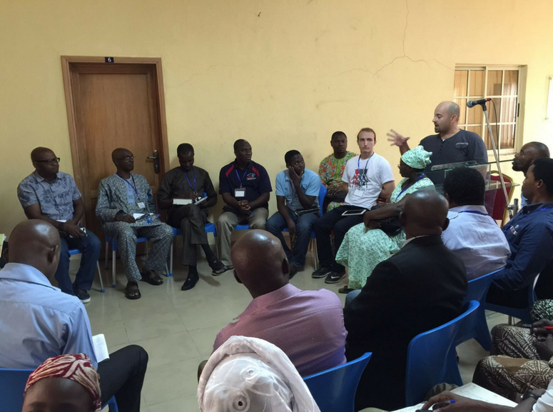
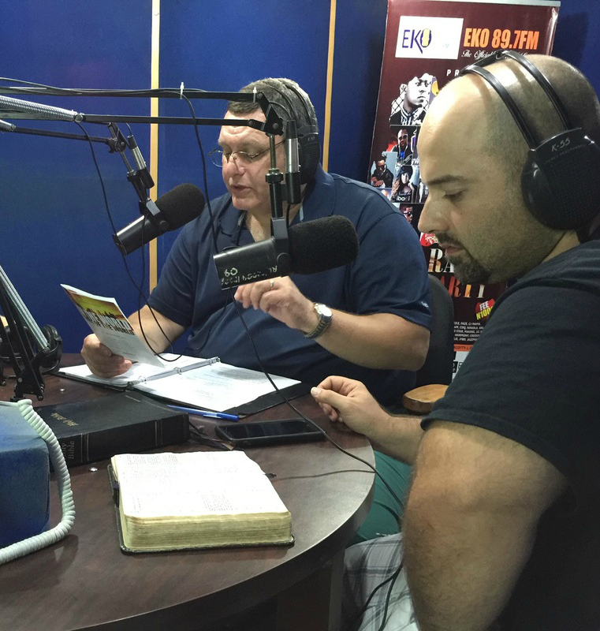
Nigeria Missions
Providing biblical literature, pastors’ conferences, radio teaching, and training for children.

Slide 43
Nepal Missions
Pokhara, Nepal

Slide 44
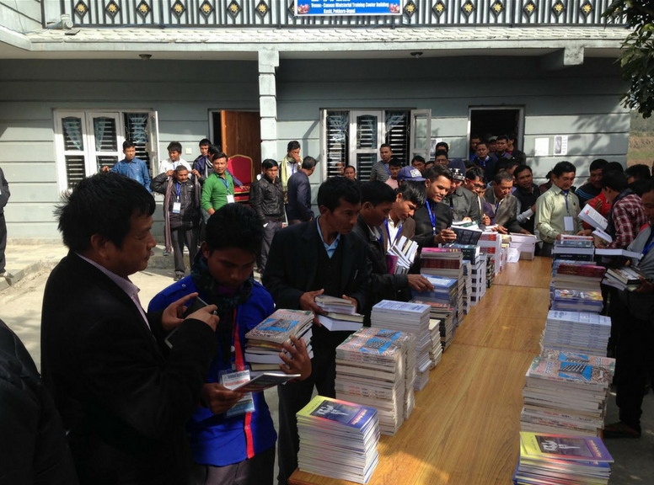
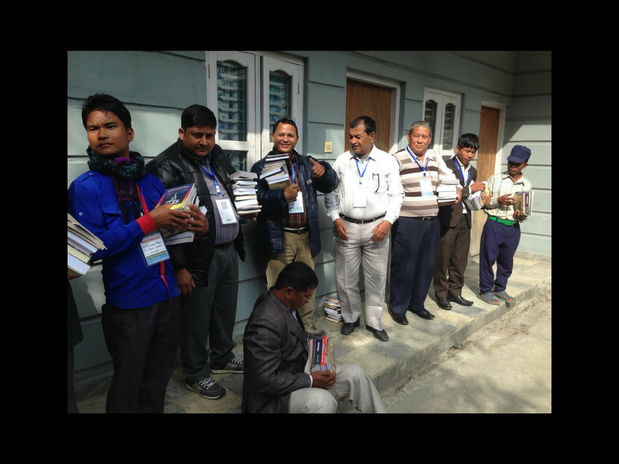
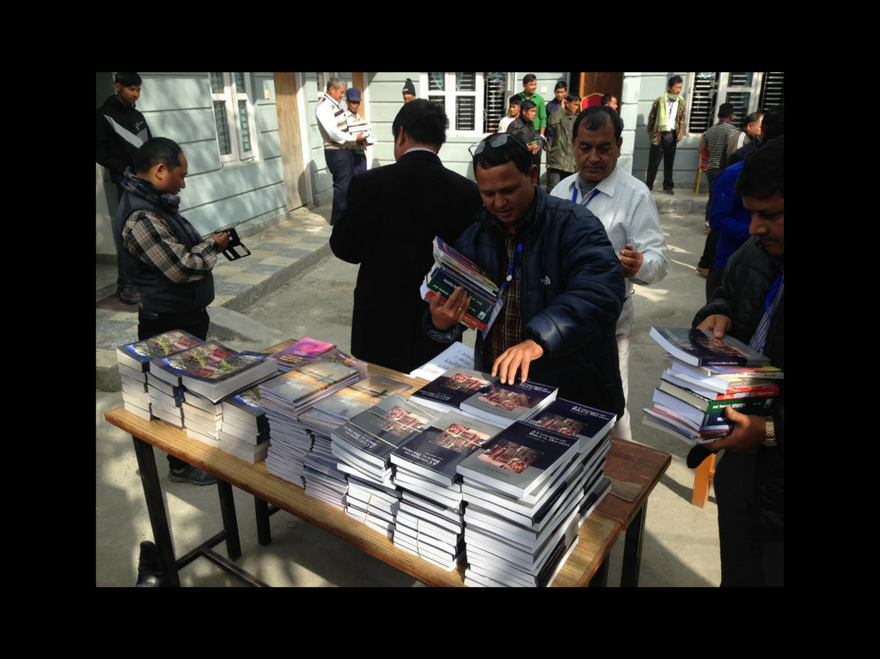
Nepal Missions
Providing biblical literature to pastors, Bible colleges, conferences, and churches.

Slide 45
Our Future
Our goal is to train—whereby we proclaim, equip, and develop—indigenous disciples who can work within their own people groups with the gospel message to initiate church planting, personal discipleship, and missions work. We are looking to conduct annual conferences and seminars in each habitable continent in the world.
Africa · Asia · Australia · Europe · North America · South America

Slide 46
Donations
FirstLove Publications is a faith ministry that relies entirely upon God’s faithfulness. We gratefully receive support from those who freely desire to give. We use donations to provide free literature to those who cannot afford it around the world. Tax-deductable donations are received at the below address or on our website:
www.firstlovepublications.org
www.missionsfirstlove.org
info@firstlovepublications.org
FirstLove Publications
P.O. Box 2190
Dublin, CA 94568

Slide 47
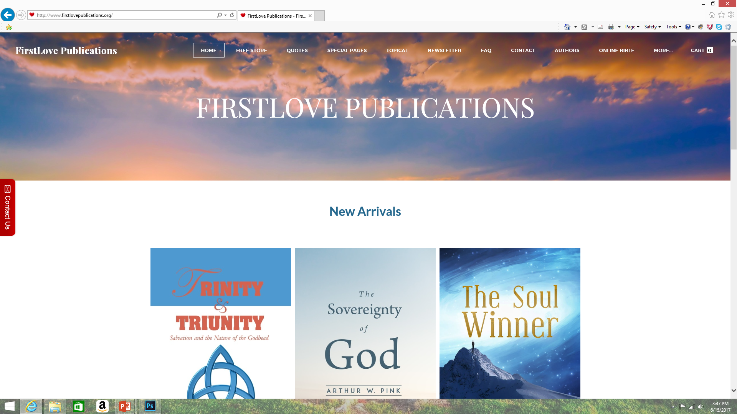
FirstLove Publications
www.firstlovepublications.org
FirstLove Missions
www.missionsfirstlove.org

